Slide 1
UML BASED GRAPHICAL MODEL

Slide 2
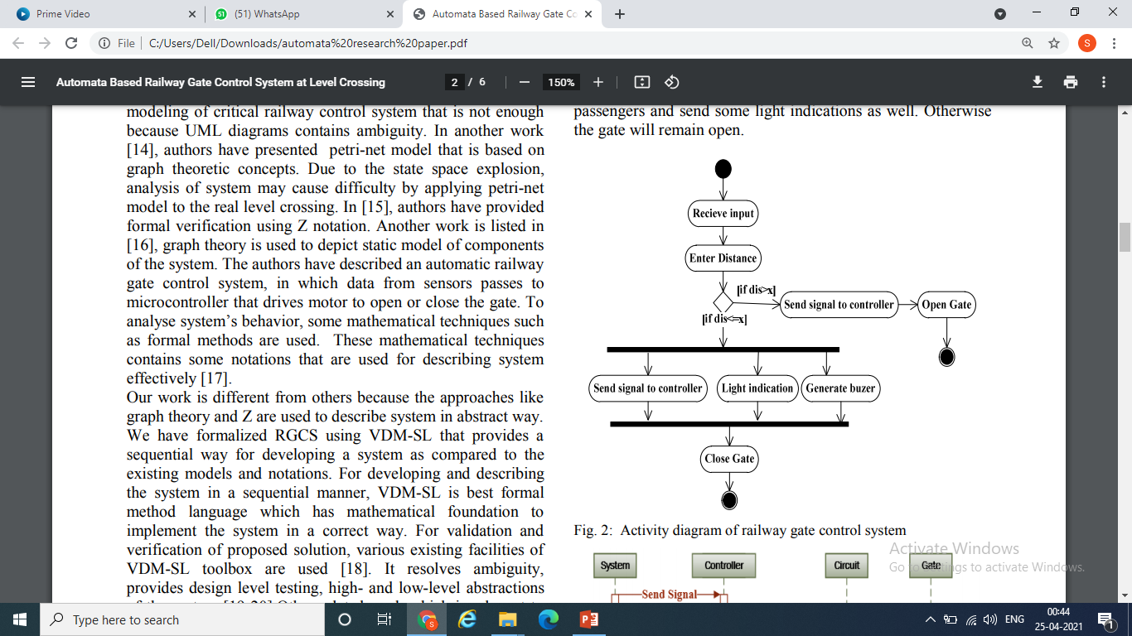
Activity diagram of railway gate control system

Slide 3
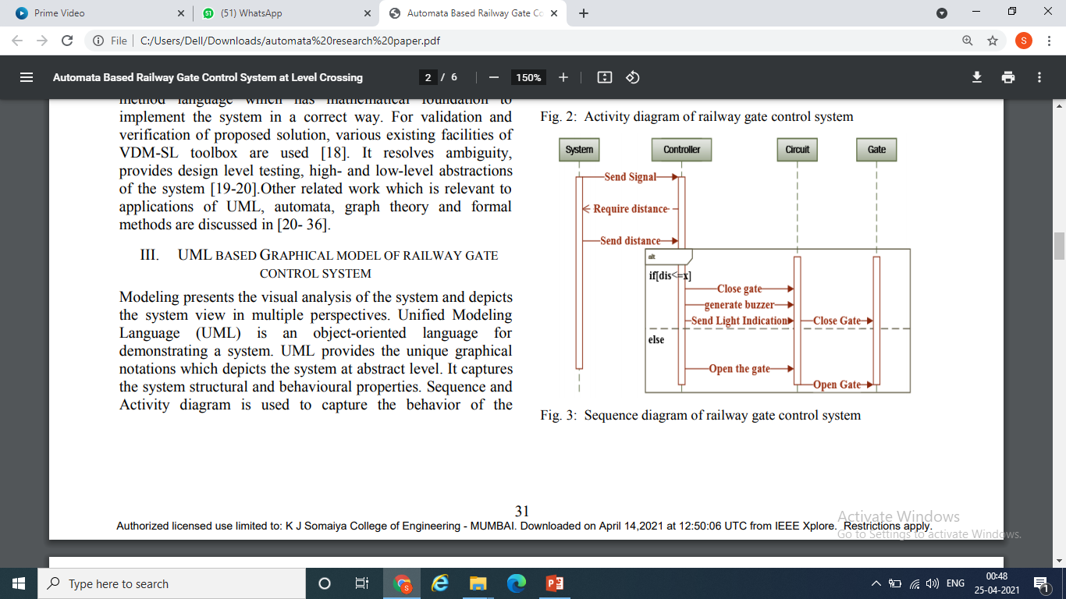
Sequence diagram of railway gate control system

Slide 4
AUTOMATA BASED MODEL OF RAILWAY GATE CONTROL SYSTEM
A Deterministic Finite Automata (DFA) consists of five components (Q, Σ, δ, q0, F)
δ : Q × Σ → Q
δ(q1, a) = q2,

Slide 5
AUTOMATA BASED MODEL OF RAILWAY GATE CONTROL SYSTEM
Finite set of states Q = {Sen, Con, Cir, Dis, Cl, OP, Buz, Lig, Dead }
Finite set of alphabets Σ = {s, c, d, l, g, b, cl} i.e., sensor, check, distance, less, greater, buzzer and close.
Finite set of final state. F = {Cl, OP}
δ: Q ×Σ → Q

Slide 6
DFA mapping
δ: Sen × s → Con
δ: Con × c → Dis
δ: Dis × d → Cir
δ: Cir × g → OP
δ: Cir × l → Lig
δ: Lig × b → Buz
δ: Buz × cl → Cl
δ: Cl × cl → Cl

Slide 7
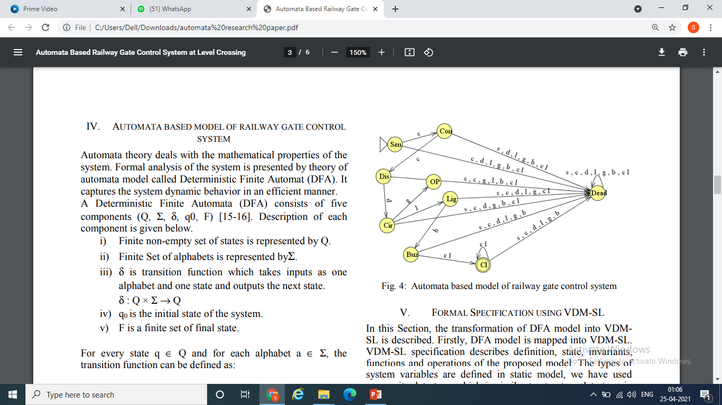
Automata based model of railway gate control system

